Slide 1
Marketing Analytics Book Reviews Case
Kayon Wang

Slide 2
Overview & Goals
Overview
Data set: book_reviews.csv (including book, review, state, and price)
Programming Language: R (with the package: tidyverse)
Goals
We want to explore the sales data to see if we can extract useful information from it and analyze what measures can be taken to increase total sales.

Slide 3
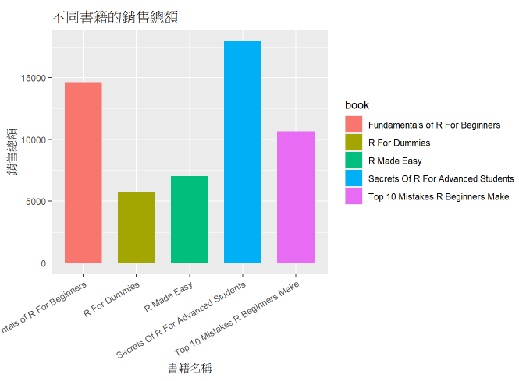
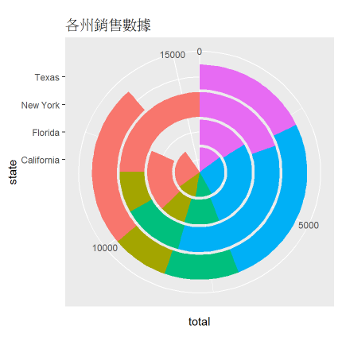
Analysis

Slide 4
Analysis
Total Sales Ranking (by Revenue):
Secrets Of R For Advanced Students
Fundamentals of R For Beginners
Top 10 Mistakes R Beginners Make
R Made Easy
R For Dummies

Slide 5
Analysis
Total sales: New York > California > Texas > Florida
Best-selling in terms of quantity / revenue in each state:
New York: Secrets Of R For Advanced Students / Secrets Of R For Advanced Students
California: R For Dummies / Secrets Of R For Advanced Students
Texas: Fundamentals of R For Beginners / Secrets Of R For Advanced Students
Florida: Secrets Of R For Advanced Students / Secrets Of R For Advanced Students

Slide 6
Summaries
From the sales revenue perspective, Secrets of R for Advanced Students performed best.
In terms of sales quantity, all five books sold similarly.
By observation, the top-ranked book primarily targets advanced readers, the other four books suggest they cater more to beginner-level readers. This indicates that the number of beginner readers exceeds that of advanced readers.
Geographically, New York generated the highest revenue.

Slide 7
Recommendations
We can deduce that the pricing falls within a reasonable range, the beginners have the willing to purchase different prices books, sales quantity appears positively correlated with reviews; advanced readers demonstrate a willingness to pay higher prices for books tailored to their needs. Therefore, we can encourage readers to leave reviews posted on the public websites and create specialized content for advanced readers.

Slide 8
References
Data Source: https://www.dataquest.io/projects/guided-project-a-creating-an-efficient-data-analysis-workflow/
Coding File: https://github.com/Gationhe/Data-Analytics-Portfolio/blob/main/book_reviews.Rmd

